Slide 1

IME Department Scheduling with Dana Azevado and Jose Macedo

Slide 2
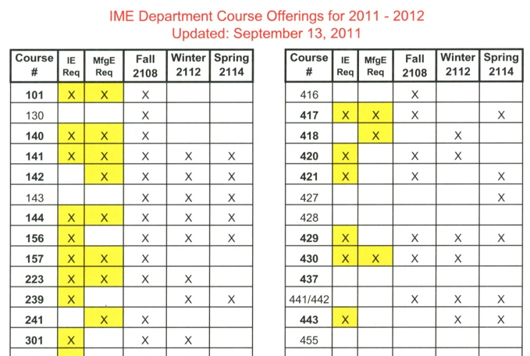

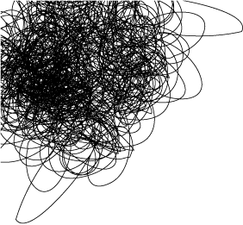
Current Process Step 1
Determine the classes for each quarter of a school year (be sure to include required courses according to major flowcharts).

Slide 3
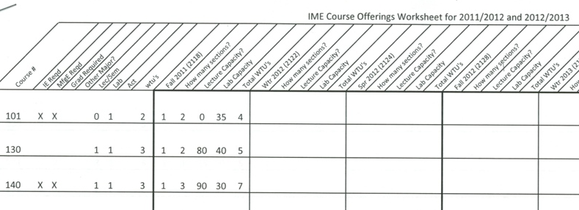
Current Process Step 2
Determine the classes for each quarter of a school year (be sure to include required courses according to major flowcharts).

Slide 4
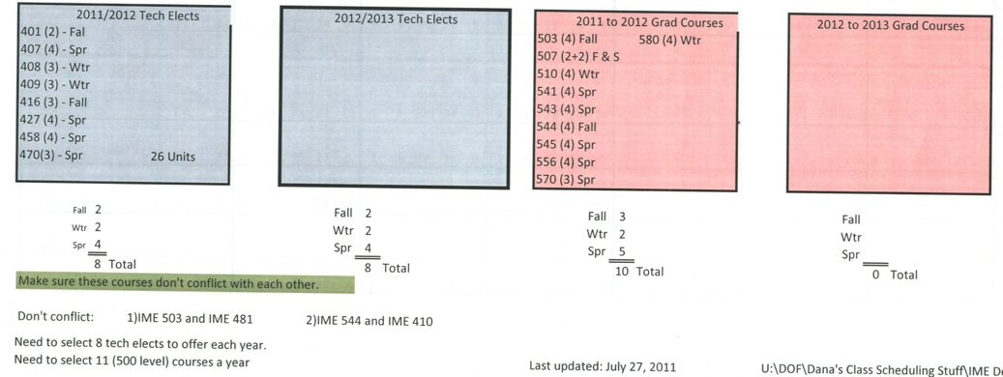
Current Process Step 2
Determine the classes for each quarter of a school year (be sure to include required courses according to major flowcharts).

Slide 5
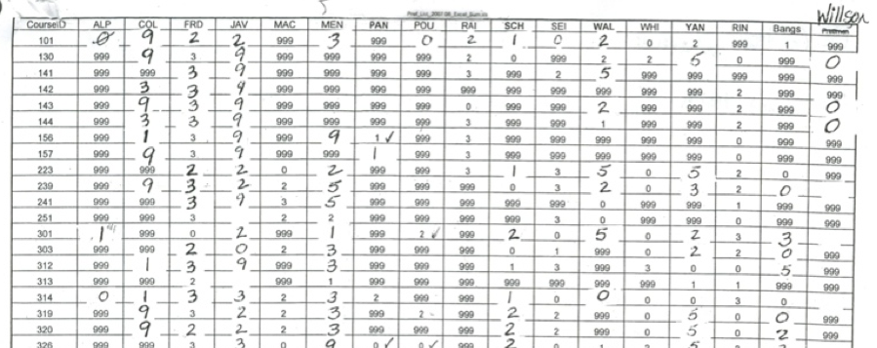
Current Process Step 3
Using a 0-9 ranking system, faculty rank their ability/desire to teach each of the classes in the department

Slide 6
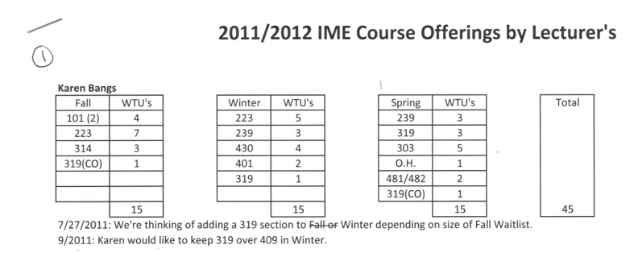
Current Process Step 4
Based on the class offerings for the year and teacher’s class preferences, the teachers are given a list of the classes that they will teach by quarter.

Slide 7
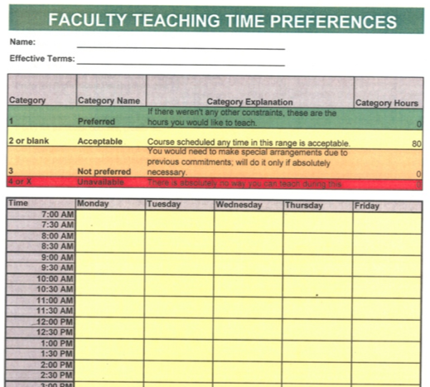
Current Process Step 5
Have faculty fill out Excel Spreadsheet with Time Preferences (use the colored rating scale from 1-4)

Slide 8
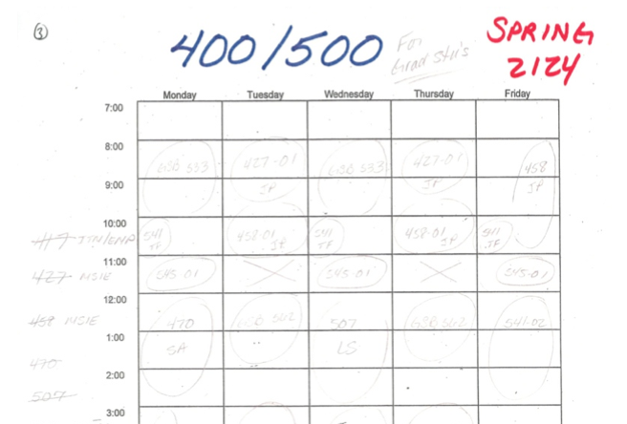
Current Process Step 6
Based on the “offered classes” list and the teacher’s time and class preferences, the classes are scheduled in “views” based on class level, instructor...etc.

Slide 9
Noted Preferences/Scheduling Restrictions
Professor Course Preferences
Professor Time Preferences
Required Course Offerings
  2-3 Tech. Electives per quarter
  2-3 Grad classes per quarter
Major Flowchart
IME has a joint program with the business school, IME schedule classes around their department
IME schedules their classes around one of the required Statistics classes
Avoid conflicts within the same level classes (i.e. all 100 level classes are offered at different times)
Avoid conflicts within 400/500 level classes (to accommodate 4 + 1 students)
The ability to see the schedule in different “view” a view that includes the schedule for each of the course levels, for each of the faculty members, for each of the rooms...etc.

Slide 10
Noted Preferences/Scheduling Restrictions
After the initial schedule is complete, often, things change (ex: maternity leave, buyout, FERPS, sick faculty, resignations...etc), they want a solution that will allow for editing/changes, with minimal changes to the existing schedule (Question for requirements team: is this preferable to the “optimal schedule”).
They spend the most time hounding faculty to get their preferences, they would like an interface for faculty to enter their course and time preferences, including:
  An “admin” page for the scheduler to use to review these preferences to see who has submitted
  The ability of the “admin” to automatically send emails to faculty that haven’t submitted their preferences yet.
  A dialog box with an error message to come up if a faculty member enters preferences that don’t include enough hours.
The option to print or export to the schedule as a file to a printer friendly format, the option to export the final schedule as an Excel file

Slide 11
Noted Preferences/Scheduling Restrictions
In the schedule, they don’t want lecturers to start early and end late
They don’t like to schedule labs on Friday afternoons
They have certain professors that are allergic to chalk and need rooms with white boards
Distance Learning or a Smart Room
Black Board or White Board

Slide 12
